Slide 1
The Threat of Terrorism
In this PowerPoint, you will learn about the threat of Terrorism to the United States and WHY certain groups have targeted the United States to get their messages across. Part of understanding why, means to understand certain pieces of the Islam religion and HOW these Radical groups have twisted those beliefs to their benefit. As I have stated in the previous lesson, this is in NO WAY intended to sway your beliefs on religion. It is for EDUCATIONAL PURPOSES ONLY. We have to talk about it in order to understand the bigger picture. I will not go in detail about Islam but only the pieces that pertain to understanding it in relation to Radical groups, terrorism and the United States.

Slide 2
Why is the US a target for terrorism?
Internationally (why the WORLD thinks bad of the US)
Domestically
The United States is seen as a Powerful and visible nation (meaning everyone sees our actions in other parts of the world)
Years of military involvement in Middle East (many believe that WE are the so – called “terrorists” and don’t believe we should be involved over there and mind our business – Remember from the previous lesson “our freedom fighter – your terrorist”).
Continued support of Israel (Before Israel became an independent nation, Israel was a shared land between them and the Palestinian people in a land called Palestine. (it is important to note that Palestine is a Muslim majority country, with only about 20% being Christian or other.) After World War 2, the United Nations, with support of the United States, made Israel its own independent country in order to create a safe place for Jewish people after the Holocaust. Israel is said to have committed a lot of war crimes towards Palestinians after its elevated status, violating human rights standards. So much in fact that Palestinians have been pushed further and further out of the land. Palestine is now not even considered it’s own country, by many, including the United States. Some say they don’t even have a defined border. After all this craziness, the Untied States continues to support Israel’s Actions. People have compared it to a big brother covering up for a little sibling that keeps fighting and beating people up so that he doesn’t get in trouble lol We could honestly create a year long class of the struggles between the Palestinian and Israeli people, that dates back to centuries to “Biblical” times. It’s all religious struggles. Each people believing they have a right to claim the Holy Land of Jerusalem
The United States has been known to Support many dictators and governments guilty of human rights violations
Extremist religious and political movements are able to harness resentment of US policies to recruit members. (Basically people who don’t agree with the US, create propaganda to make us look TERRIBLE and thus gets people against us).
Rapidly changing economic and political environments
Fear of government intrusion into the lives and rights of the people. People often fear that the government will take away citizens constitutional rights (SO LOOK: recently with this whole coronavirus stuff... People protesting in Michigan went to the Michigan State House with WEAPONS demanding that their state government open the state back up. IFFFFF those protestors had acted with their weapons and actually used them….would they be considered domestic terrorists???? Or Freedom Fighters???? What do you think??? I am telling you guys, we live history every day...it’s insane.
Racist ideologies (RADICAL people in the United States tend to not be welcoming to other ethnicities, cultures, religions, therefore does not agree with some Government policies regarding these things).
Anxiety about the future (people just freaking out about other things)

Slide 3
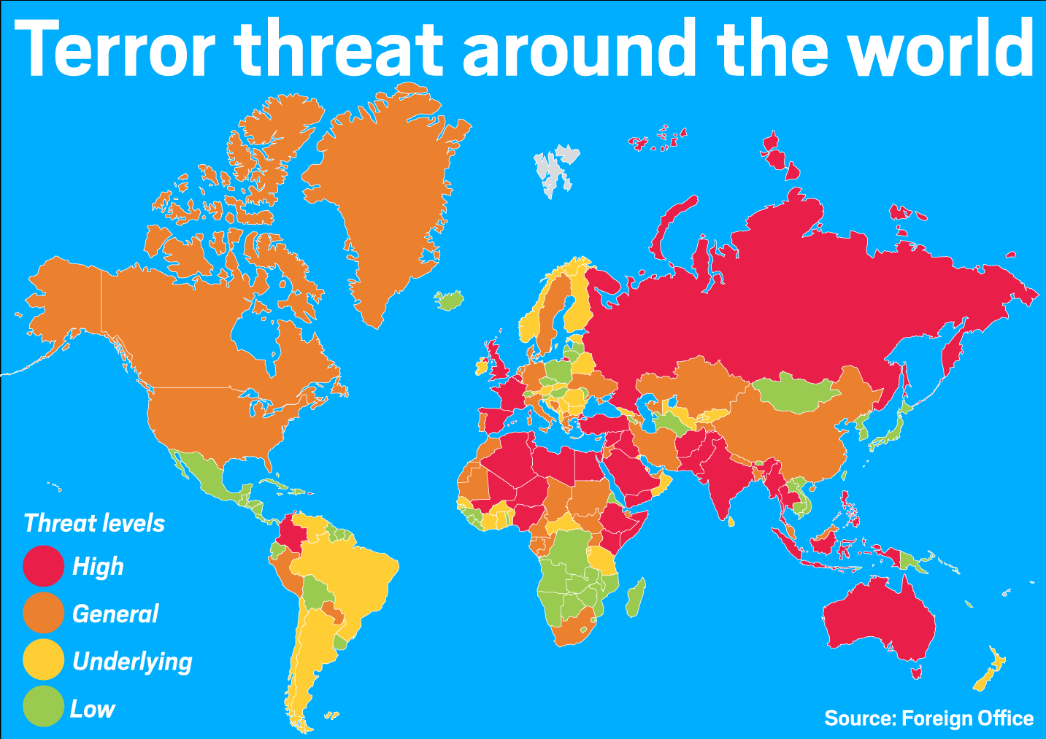
Terrorism is a global problem – you will have a reading in the next assignment about how terrorism affects other countries.
US not only country to be affected by terrorism or increased terrorist attacks
Some areas have seen greater share of terrorist attacks, way more than even the United States has experienced.
Countries in the Middle East, East and West Africa, and South Asia
Example: Pakistan saw 19 suicide attacks in 2015 vs 2 in 2003 → More than 20,000 civilians have died in terrorist attacks since 2003
Many countries have begun to work together to stop terrorist plots
2001 – American Airlines crew and passengers stopped a man from setting off a shoe bomb on a plane
2006 – US, Britain, and Pakistan stopped liquid bomb from making it onto a plane
2009 – passengers stopped a man from setting off a bomb in his underwear

Slide 4
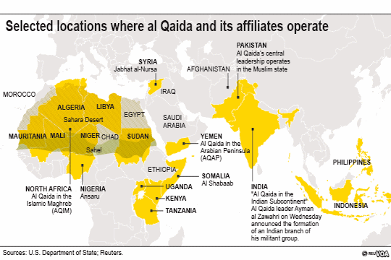
Al Qaeda – alright now we are going to talk about al-Qaeda, the radical Islamic group that claimed responsibility for the 9/11 attacks in 2011
The name is loosely translated in Arabic as “the base”
Led by Osama bin Laden (pictured to the right)
Claimed responsibility for 9/11 and other attacks on US embassies and military bases
Goal – to rid Muslim majority countries of US influence and replace with a caliphate
Caliphate is a medieval term for an Islamic state (basically it would be a country that is ruled by Islamic law/Religious law. Everything they do, including their laws would be based off the Islam religion…but REMEMBER these guys are RADICALS so it is THEIR interpretation of Islam which is usually all distorted
Follows extreme and intolerant interpretation of Sunni Islam
The goal of Jihad in the Radical sense:
Jihad is a belief in the Islam Religion.
Scholarly interpretation of this word – “struggle or effort”
Bin Laden’s interpretation – used as a term to describe a holy war against the “enemies” of Islam → is now often connected to terrorists and extremists
Jihad. This is a word that over time has gained a negative connotation, especially in the United States. Jihad in the Islam religion means to fight the struggle of sin WITHIN YOURSELF or to SPIRITUALLY fight off opponents of Islam or bad influences not supported by Islam. In the Islamic religion, it is a SPIRITUAL thing. More like “hey let’s not let sin influence us so that we remain pure for God.” So, many who abide by Jihad will do just that…make sure that they are spiritually in the right place. That’s it. BUT RADICAL ISLAMISTS have taken Jihad to a whole other level. They have interpreted it LITERALLY….and have waged a real life all out holy war against opponents of Islam or those that they feel are a threat to the Islam religion. In their interpretations…this means ATTACK when necessary in order to protect Islam. They have taken the word FIGHT in literal sense in order to justify their attacks. This is why MANY people believe that Islam condones violence….when that is not the case at all. This is the interpretation and belief of RADICAL Islamic groups like al-Qaeda, ISIS and Boko Haram. Which is why you will see them up in arms and carrying out actual attacks or suicide bombings. Many Muslims have actually spoken out AGAINTS these radical groups, reiterating that they do not believe how the radical groups believe. I hope this makes sense lol message me if you need more clarification.

Slide 5
Al Qaeda (continued)
Why the US?
Angered about US involvement in Middle East, esp. Saudi Arabia, US policy in Iraq, and US support of Israel
Rising Islamophobia
Osama bin Laden used his beliefs about Islam to explain his motivations → many begin to believe that Islam is violent and that all Muslims believe in this interpretation of Islam…which is not true.
Rising hate crimes towards Muslims especially after 9/11
Al Qaeda today
Osama bin Laden was killed on May 1, 2011
Weakened structure of the al-Qaeda organization
Still plan attacks, but more a loosely connected collection of small groups around the world. They now have bigger and more powerful groups in the world, like ISIS (Islamic State of Iraq and Syria) in the Middle East and Boko Haram in the West Africa region. Boko Haram literally means “Western Education is Forbidden.” The United States and it’s allies is considered “western.” Don’t get this confused because they are from West Africa lol has nothing to do with that.

Slide 6
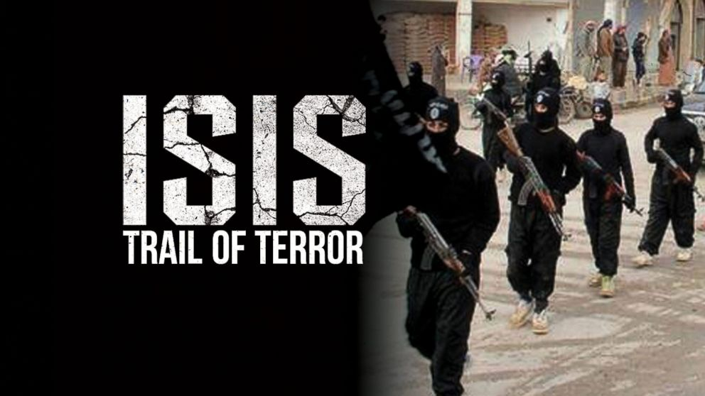
International Terrorism
Weakening of al Qaeda has not stopped terrorism→ has inspired new groups
ISIS or ISIL
ISIS – Islamic State of Iraq and Syria
ISIL – Islamic State of Iraq and the Levant
Offshoot of al Qaeda
Initially targeted Shi’i Muslims and other religious groups in Iraq and Syria, but has continued to spread their attacks globally
Boko Haram
West Africa
Pledged allegiance to ISIS
As of 2014 has killed 6,664 people in attacks
Social Media and the internet
These new groups have harnessed power of social media and internet to recruit members and spread message

Slide 7
Assignment 13 – this is more of a check in lesson to make sure you understand so far. Read the questions below and answer in your OWN words. DO NOT copy and paste the answers from the PowerPoint.
SUMMARIZE in your OWN words, Internationally - why is the United States a target for terrorism??? Make sure you hit all the points.
SUMMARIZE in your OWN words, Domestically – why do people carry out terrorist attacks??? Make sure you hit all the points.
Look at the map in the 2nd slide after the title – the word has been categorized by how likely they are to EXPERIENCE a terrorist attack on their soil… (if you can’t see the map, message me on remind and I will send it to you).
The Untied States is at what “threat level” for terrorism?
Give me the name of at least 4 other countries who are at the “high” threat level…yes you may have to look at another map to figure out the names lol
For the countries at the “low” threat level...like Mexico...WHY DO YOU THINK they are least likely to experience a terror attack on thier soil? Think deep here…there is no right or wrong asnwer...but based off the PowerPoint and what you learned, give me your analysis.
What was al –Qaeda’s ultimate goal and how have they gone about attaining thier goal?
What two radical Islamic groups arose after the killing of Osama Bin Laden?

