Slide 1
DISCLAIMER – I give this speech to my students every year as we continue with this unit on terrorism…
We are going to be talking about religion in this piece. We CANNOT talk about or understand this piece on terrorism and how it relates to the United States unless we talk about it. I want to be VERY, VERY clear to you all that this is in NO WAY preaching ANY religion to you…or in NO WAY is this trying to get you to change your thinking or anything like that. This is ONLY FOR EDUCATIONAL PURPOSES for this unit so that you can understand the events we will be talking about. Again it will be hard to understand the basis of this unit without talking about it. I will give only the facts...NEVER, EVER my personal opinioin as I always do when talking about controversial topics! Usually students understand this very well, and I have never had a problem in the past, but I feel it is importatnt to tell you all this anyway ☺ and especailly since I am not in person teaching you this. If you have any further questions, concerns, comments PLEASE feel free to reach out to me! This is ultimitely one of our more interesting units...hopfully it will be the same even though we are distance learning! ☺

Slide 2
Quick words to know
Radical: means extreme
Islamic: related to the Abrahamic religion Islam
Muslim: PEOPLE of the Islam religion. So when people say they are Muslim, that means they are part of the Islam religion. You don’t call them Islam, you call them Muslim. (a lot of people have gotten this confused lol)
al-Qaeda: radical Islamic group based in Afghanistan. (It is important to note, however, that many of the men in the group were from other Arab nations, like Saudi Arabia).
Oral History: History that is told by word of mouth, rather than reading it in a book, etc.

Slide 3
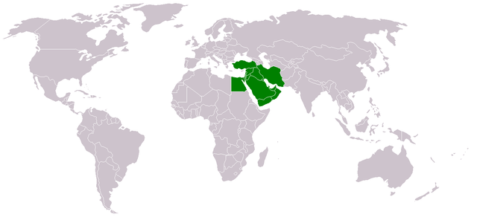
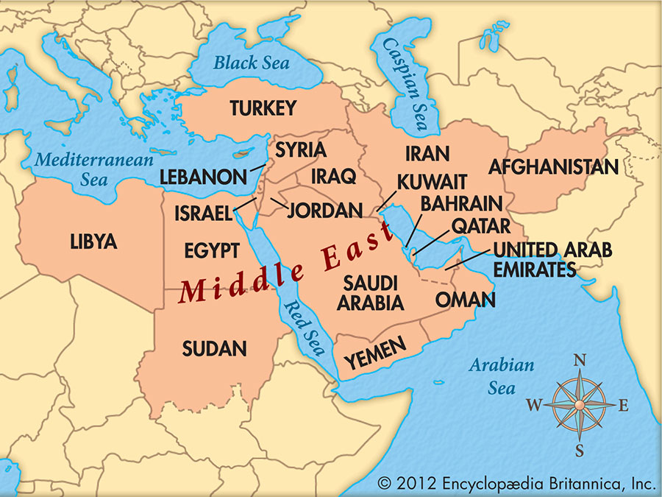
Begin here. Map of the Middle East…check it out. It’s important to know WHERE we are talking about. Familiarize yourself with the names. No need to memorize though, just familiarize.

Slide 4
Next, read here:
September 11th, 2001. This date means different things to many people. For some, it is just a regular day (I think some of you were not even born yet), but for others this means a whole lot more. September 11th was a day that changed the United State’s view and stance on terrorism. On this day, the United States experienced 4 planned attacks by the radical Islamic group al-Qaeda. They hijacked 4 planes, 2 of which were driven into New York’s World Trade Centers, 1 plane hit the Pentagon near Washington DC., and 1 crashed in Pennsylvania after the passengers decided to fight back (they have a movie on this one that we would normally watch in class…called Flight 93, if you’re interested). In all, about 25,000 people were injured and close to 3,000 dead. The motives for the attack???? Well…that is a long answer that we can honestly create an entire year long class out of....but for the purpose of this...just know that it is years and years and years of United States involvement in the Middle East....that many people were and are still opposed to (we will talk a little bit more about this later on). (A couple side notes before we move on: there was a first attack back in 1993 on the World Trade center...but it didn’t create AS of an impact as the events on 9/11/2001. Also, I want to be VERY clear here on the word RADICAL ISLAMIC group. This means that yes, they are a religious group based on Islamic principles BUT BUT BUT these radical groups take those religious ideas and principles to the EXTREME. In other words, they have twisted the principles of a religion to fit thier own political agendas and goals. They are NOT representative of the religion Islam or its people. Fundamentaly, Islam is considered a very peaceful religion and, in fact, MANY Muslims do NOT agree with what these radical Islamic groups are doing as the religion fundamentaly does not beleive in violence. This is a fact and many Muslims have actually spoken out agaist these radical groups. I think it’s also importatnt to note that there are radical groups in every religion or activist group. For example, there are radical Christians, radical Catholics, radical animal rights activists etc etc etc...the list goes on. So please, I need you all to understand we are talking about RADICAL groups here (we will get into more of what this means later on) but just know that they are not reprsentative of all in this religion. That is why they are called “radical”.

Slide 5
Assignment 12 – PART 1 Directions:
Please watch the TWO following videos on 9/11 and answer the questions that goes with them. You can type your answers directly on the word document or type them up on a google document. When finished, proceed to the next assignment.( Part 1 and part 2 will go on the same document. )

Slide 6
Video 1 – events of 9/11
https://www.youtube.com/watch?v=1lKZqqSI9-s&list=PLhAqligcqptPZRWZSABTwHBGpv7XoGPMS&index=1

Slide 7
Video 2 – President Bush’s Speech given after the attacks on 9/11
https://www.youtube.com/watch?v=3dTsbPje_6k&list=PLhAqligcqptPZRWZSABTwHBGpv7XoGPMS&index=9

Slide 8
When you are done watching the videos, read here next!!! Another story time from Ms. Reyes, but this will allow you to understand the purpose of the next assignment. It is an oral history of my account of 9/11…of what I remember from that day and how it affects me today. Oral Histories are important because it allows you to see events from different perspectives. Enjoy!
Although terrorism had of course already been around before the attacks on 9/11, this event seemed to hit the hearts of many Americans of all backgrounds. A lot of people were affected in many different ways. Some people weren’t affected at all. I will tell you my experience. I am a Mexican-American living on the west coast. I was far away from the attacks at the time. I was in 3rd grade when it happened. The morning of the attacks, I remember getting ready for school as usual. I remember walking into the living room and my mom turning off the TV as I walked in (my dad was already at work). I didn’t think much of it except that it was weird…but then she got a phone call from my brother. I heard him yelling over the phone telling my mom not to let me go to school. In my 3rd grade mind, hearing my older brother freaking out must have meant it was serious....so then I got scared....still unsure of what though lol...but I was still scared (remember this is 3rd grade Ms. Reyes). Anyways, my mom made me go to school. It was a really quiet day and I remember not doing much. Not a lot of kids were there and the teacher didn’t even say much. Things didn’t feel “normal.” Later, my mom picked me up and we went home. Later that night, my family explained AND showed me what had happened. In my 3rd grade mind...I was terrified. I legit remember feeling that if you traveled at all that meant you were at risk of dying or getting attacked. I remember my mom was scheduled to go on a cruise for her job and I BEGGED her not to go. I really thought she would be a gonner if she went. She ended up going, and I creid my eyes out. But you have to understand, as a 3rd grader, I didn’t know to think any better. They told me over and over everything was fine...but in my mind I just kept thinking...HOW DO YOU KNOW. As a ittle girl, the only thing I understood was fear. I remember watching the world around me change. I remember people becoming so racist towards anyone of middle eastern heritage. They went from not being talked about at all...to that’s all people talked about! I rememebr the anti-middle east or anti-Muslim propaganda in the news or in other random places. I remember feeling sad for them and I remember my mom telling me that the mean way people acted towards others was not okay becasue this was the fault of a small group of people and not the whole. I am forever grateful my mom taught me the difference. It was definitely a strange time...for a long time actually. Some Americans became fearful of a group of PEOPLE but I became fearful of just traveling lol To this day I am terrified of airplanes!!! I get so anxious to travel or even get on a plane. (Fun fact: I make my family members call me or text me as soon as they get off the plane or arrive where they need to. I freakout if I don’t hear from a loved one for more than a day if I know they are traveling somehwere). It’s definitely odd...but I guess it was just something psychologically I never worked through since it first happened when I was little and thus....this is how it affects me today. Like I said before...this day impacted people in MANY different ways...and it could be interesting to hear these oral histories of how people experienced certain events. It definitely gives you a different perspective on things and people! You get to learn a little bit more about people if you take the time to understand thier histories!

Slide 9
Assignment 12 - Part 2 Oral History Assignment
Directions: Interview someone you know about September 11. The person should be 26 years of age or older.
Things to consider before doing an interview:
This topic is a sensitive topic. Many people were directly affected by this event, so consider that when interviewing them.
When interviewing people give them time to think about the question. Be patient! And, listen/write down their whole response.
You may record the interview if the interviewee says yes

